Slide 1
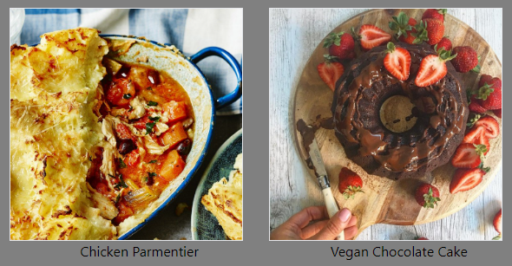
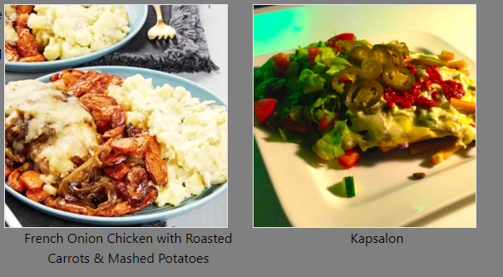
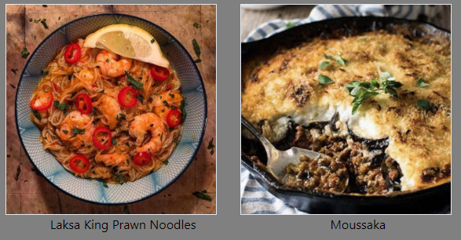
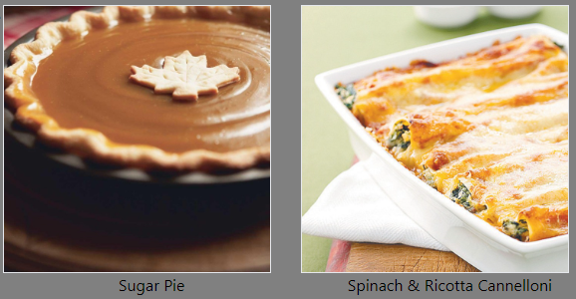
The food tracker
Awais Aslam
Gonzalo García Rivera

Slide 2
WHO WE ARE?
The Food Tracker is a sophisticated food search platform that allows the user to discover new recipes from all over the world to prepare.
You can choose a meal through different criteria:
Through the five most popular dishes
Through featured ingredients -> you will be directed to every dish that employs a particular ingredient.
A random list of five dishes -> constantly updated every time the site is refreshed.
Through every country whose database has at least one meal incorporated.
When you select a meal based in any of these criteria, you will be directed to the recipe section, which contains the list of ingredients with its picture and measures as well as the preparation process.

Slide 3
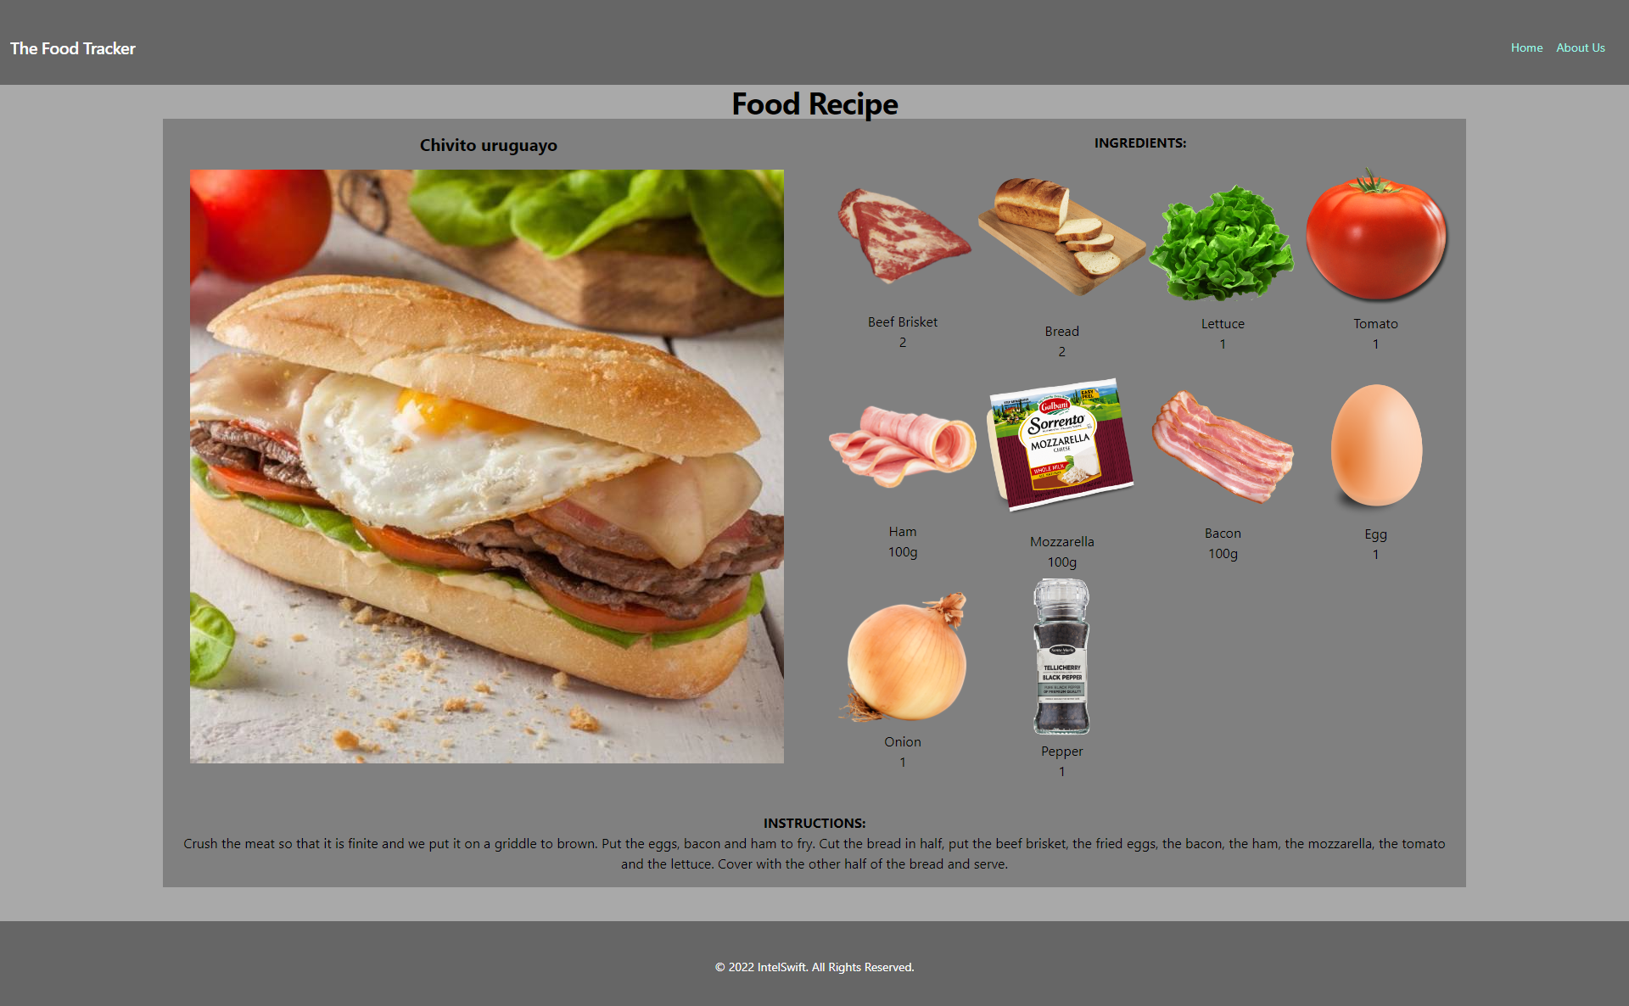
SEARCH FOR YOUR RECIPE
Header & Navigation
Your selected dish
List of Ingredients
Cooking instructions
Footer

Slide 4
Concept
Description
The Food Tracker is an online search platform that has multiple criteria selection to access for different types of dishes from all over the world. These criteria selection comes in different fields from ingredients, meals by country, popularity or randomly selected.
Motivation for development?
Develop a platform that will connect people across the world by trying new dishes from unexpected places.
Present and upgrade the platform by incorporating new functions and features in every upcoming version.
User story
AS A food enthusiast
I WANT to see try new dishes from different places based on its ingredients and cooking process.
SO THAT I cook them more frequently

Slide 5
Process
Technologies used
VS code -> html, CSS and JavaScript files
CSS framework -> Tailwind
Web APIs from https://www.themealdb.com/
Breakdown of tasks and roles
Development of the Main page
AA -> Sections: Popular Ingredients / Random Meals / Browse Countries
GG -> Sections: Popular Meals / Navigation (Home & About Us) / Header / Footer
GG -> About Us section
AA -> Ingredients & Meals by country sections -> link to Food Recipe Section
AA & GG -> Food Recipe section
Challenges
Create the Js files and sync the functions through the HTML docs to develop the search & result sequence.
Update each HTML doc constantly through every new function created to sync it with the other HTML docs through the JS files.
Successes
Development of MVP version that includes the basic display segment, search food by different criteria and food recipe segment

Slide 6
Demo

Slide 7
Directions for Future Development
Version 1 -> Inclusion of a search option for meals
Version 2 -> V1 + Inclusion of a search button to a new section of all ingredients
Version 3 -> V2 + adding new countries
Version 4 -> V3 + adding new features like taste property (sweet, salty, bitter, etc.)
Version 5 -> V4 + adding nutritional component

Slide 8
Links
Deployed
GitHub repo - https://github.com/Ggariv/Project-1

